Slide 2
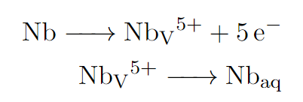
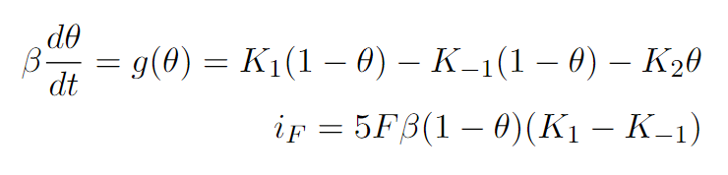
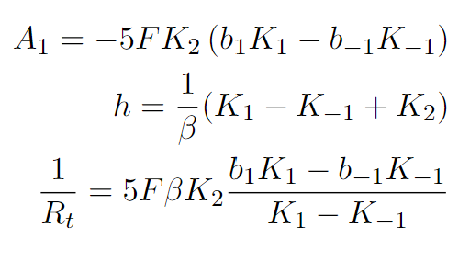
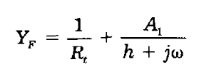
A Physiochemical Model of Nb Electropolishing
A two-step reaction is used to model the Nb electropolishing.
Oxidation of metallic Nb to Nb(V)
Dissolution of Nb(V) into the electrolyte
The variable Θ is the fraction of the electrode covered by Nb(V).
The variable β is the surface density of reaction sites available.
K_{n} is the forward or reverse reaction rate constant of the n-th reaction step.

Slide 3
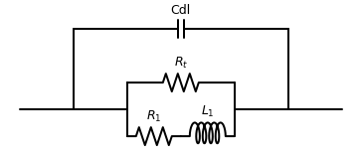
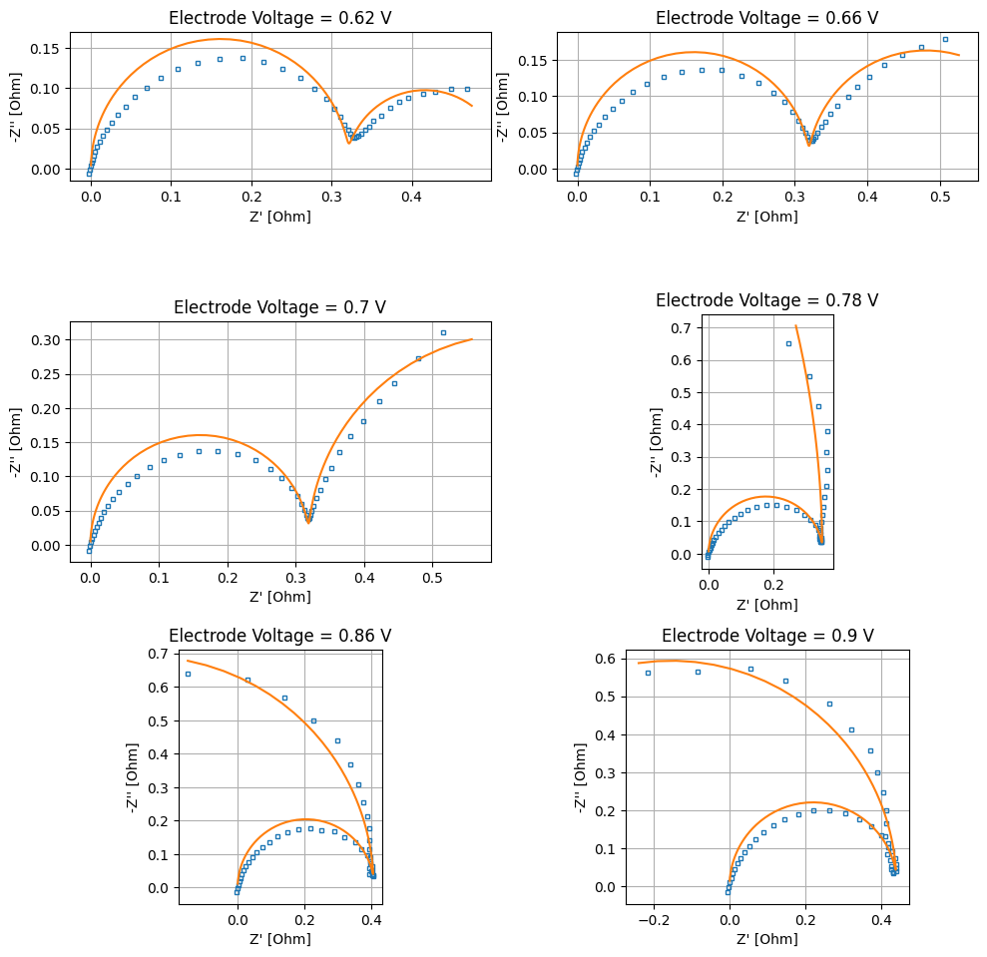

Slide 4
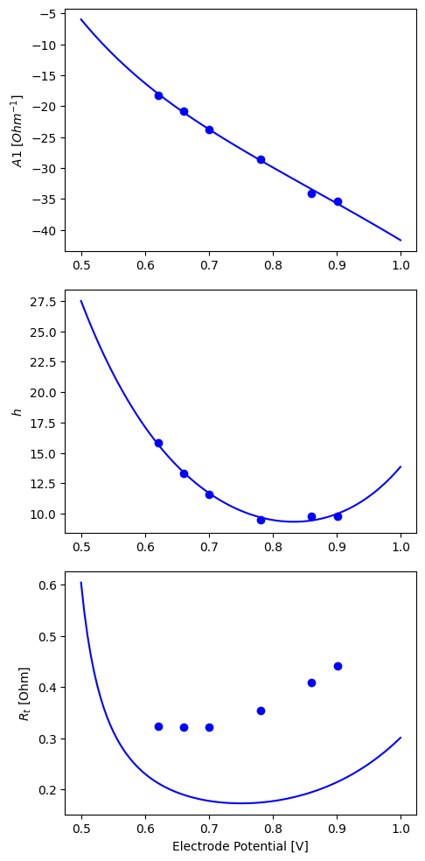

Slide 5
